Slide 1

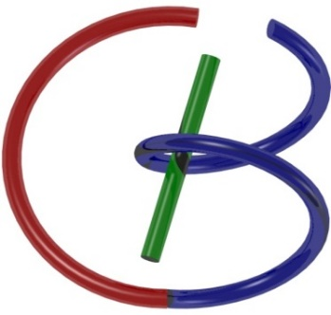

Nuclear Physics
Ge Wang
AI-based X-ray Imaging System (AXIS) Lab
Rensselaer Polytechnic Institute, Troy, New York, USA
November 5, 2021

Slide 2
MI Schedule for F21
Tue | Topic | Fri | Topic
08/31 | Introduction | 09/03 | Neuron, Network & Backpropagation
09/07 | No Class | 09/10 | Hands-on 1: Python, Colab, & TensorF
09/14 | Architectures & Training | 09/19 | Hands-on 2: MNIST Classification
09/21 | Image Quality I | 09/24 | CT Physics
09/28 | CT Reconstruction | 10/01 | Deep CT Reconstruction
10/05 | Hands-on 3: CT Networks | 10/08 | More CT Contents
10/12 | MRI Physics | 10/15 | Spin-Echo
10/19 | K-Space Theorem | 10/22 | More MRI Contents
10/26 | Mid Exam | 10/29 | Deep MRI Reconstruction
11/02 | Hands-on 4: MRI Networks | 11/05 | Nuclear Physics
11/09 | Nuclear Imaging | 11/12 | US Imaging
11/16 | Optical Imaging | 11/19 | Multimodality Imaging
11/23 | Hands-on 5: Image Conversion | 11/26 | Thanksgiving
11/30 | Image Quality II | 12/03 | Stability, Interpretability, & Others
12/07 | Overview | 12/10 | Final Exam
Office Hour: Teaching Day 5-6pm: https://rensselaer.webex.com/meet/wangg6

Slide 3
Outline
Introduction
Beyond CT & MRI
Nuclear Imaging
Similarities & Differences
Nuclear Physics
Single & Paired γ Photon Emission
Imaging Models
SPECT & PET Systems
Key Components
Image Quality Issues
Novel Nuclear Imaging

Slide 4
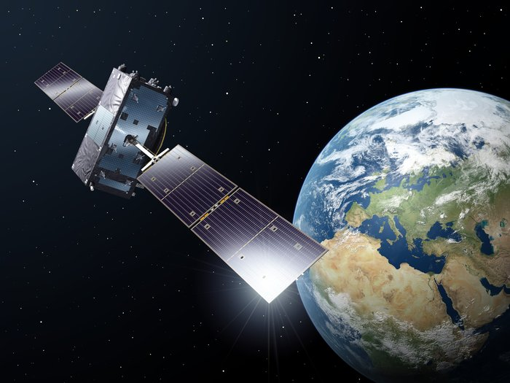
Earth Tomography
Tomography

Slide 5
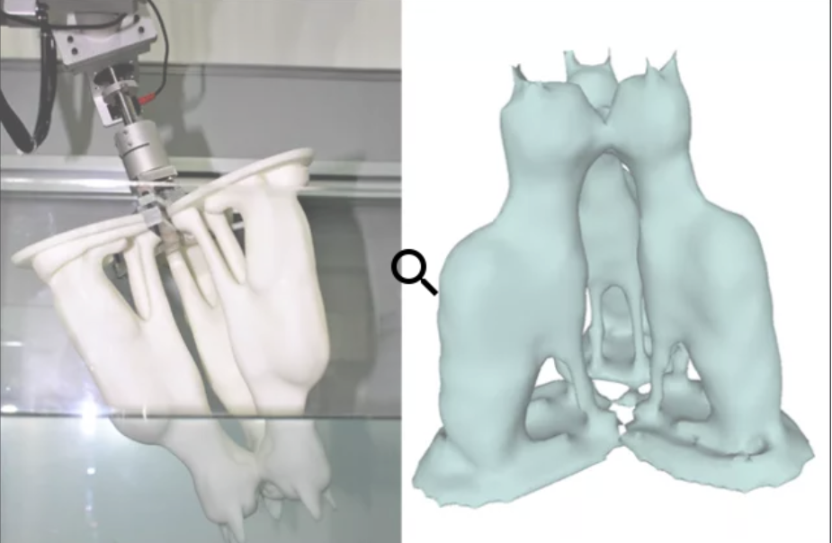
Water Tomography

Slide 6
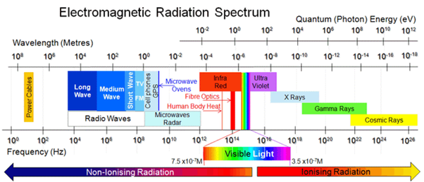
X-ray versus γ-ray Radiation

Slide 7
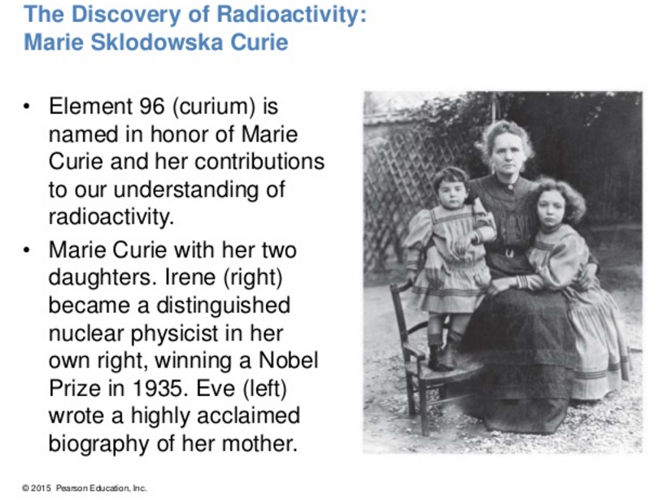
Marie Curie

Slide 8
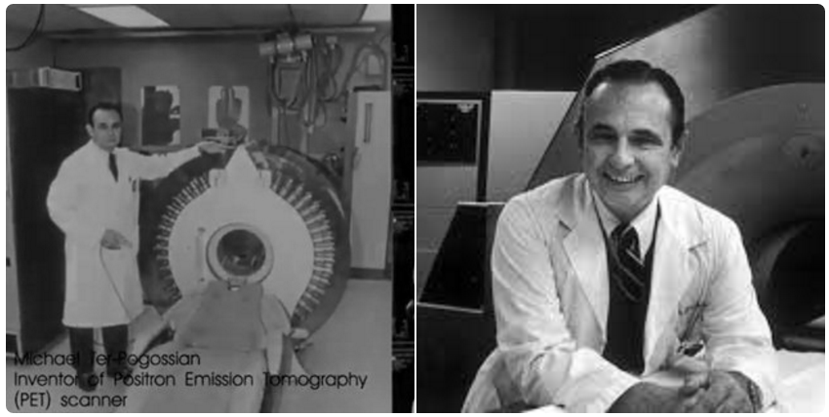
Michael Ter-Pogossian
Michel Matthew Ter-Pogossian (April 21, 1925 – June 19, 1996) was one of the pioneers of positron emission tomography (PET), the first functional brain imaging technology. PET can evaluate the brain during mental processes versus structural imaging by conventional CT.

Slide 9
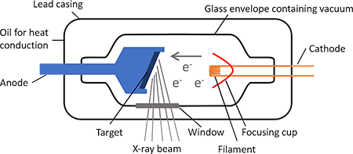
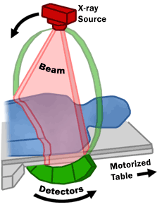
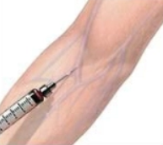
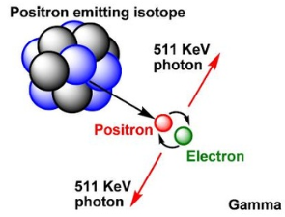
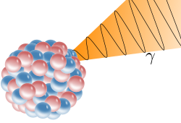
External vs Internal Source
Gamma photon
Gamma photon

Slide 10
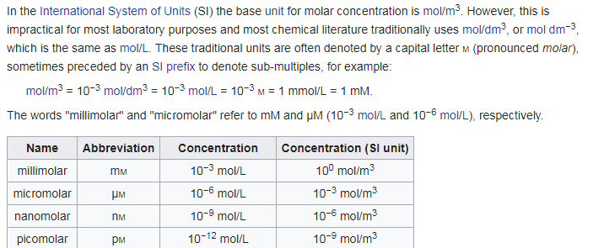
Molecular/Tracer Sensitivity
The mole is the unit (SI) for amount of substance, defined as the amount of substance as many representative particles as there are atoms in 12 grams of carbon-12 (¹²C). This number is the Avogadro constant, ~6.022140857×10²³ mol⁻¹. The mole has the unit symbol mol.
Mole: SI Unit; Amount of Substance
mol/m³: SI Unit; Concentration
Mole and Molar: Impractical
M: mol/dm³
mol/m³=10⁻³mol/dm³=10⁻³M=1mM

Slide 11
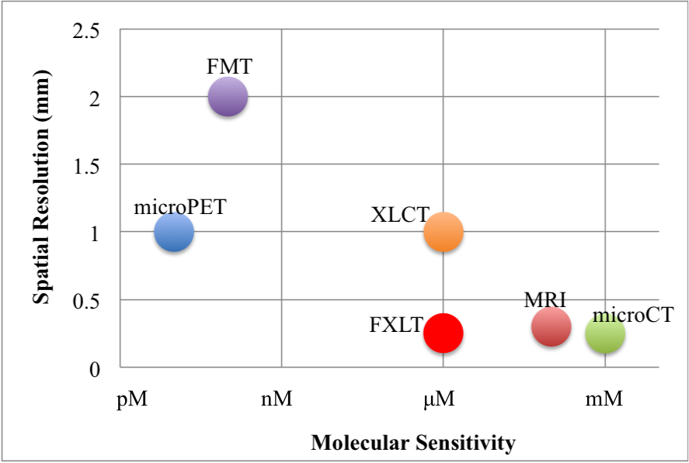
Tracer Sensitivity
From an R01 proposal led by Changqing Li, in collaboration with Jeffrey Anker and Ge Wang

Slide 12
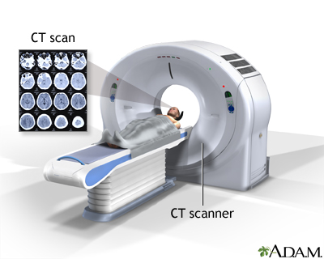
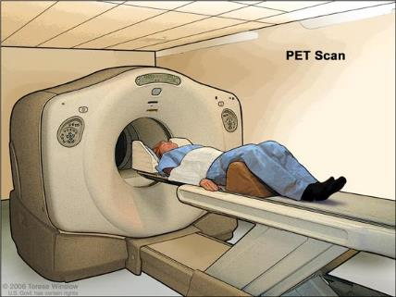
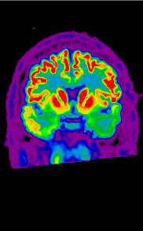
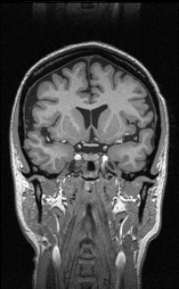
Similarities & Differences
Similarities
Similar Energy Levels
Straight Ray Geometries
Line Integrals
Tomographic Recons
Differences
External vs Internal Sources
High vs Low Flux/Resolution
Low vs High Sensitivity
Anatomical vs Functional

Slide 13
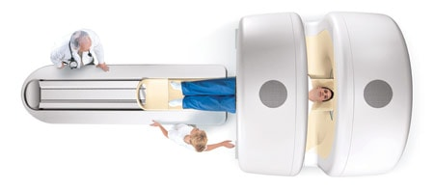
PET-CT Scanner

Slide 14
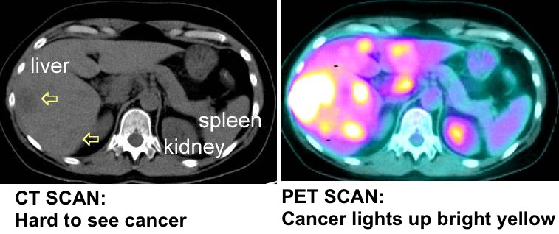
PET-CT for Cancer Imaging

Slide 15
Outline
Introduction
Beyond CT & MRI
Nuclear Imaging
Similarities & Differences
Nuclear Physics
Single & Paired γ Photon Emission
Imaging Models
SPECT & PET Systems
Key Components
Image Quality Issues
Novel Nuclear Imaging

Slide 16
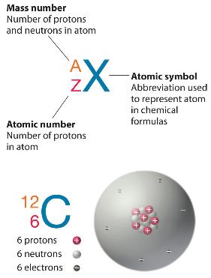
Radionuclides
Radioactive decay modes
Nucleon emission/capture
β⁻ emission
Electron capture (EC)
Positron emission (β⁺ decay)
Nucleon emission/capture
Heavy damage to tissue -> used in radiotherapy
Example: α emission: (kinetic energy: 3-7 MeV)

Slide 17
atomic number: the number of protons in the nucleus of an atom
mass number: the sum of the number of nucleons (neutrons and protons) in an atomic nucleus
isotopes of a chemical element have the same atomic number (number of protons in the nucleus) but have different mass numbers (from having different numbers of neutrons in the nucleus).
Example: ¹²Carbon and ¹⁴C (6 protons and 6 resp. 8 neutrons)
Different isotopes of the same element cannot have the same mass number, but isotopes of different elements often do have the same mass number
Examples: ⁹⁹Mo and ⁹⁹Tc
¹⁴C (6 protons and 8 neutrons) and ¹⁴Nitrogen (7 protons and 7 neutrons)

Slide 18
β⁻ emission: tissue damage
immediate release of γ-photon
metastable state (preferred) -> delayed release of γ –photon
e.g. ⁹⁹Mo (half life = 66 h) -> ^{99m}Tc (half life = 6 h) -> ⁹⁹Tc
E_{γ} = 140 keV
OR
atomic number + 1
same mass number
γ

Slide 19
Electron capture (EC)
atomic number - 1
same mass number
γ
e.g. ¹²³I (half life = 13 h)

Slide 20
Positron emission (β⁺ decay)
(+ γ-photon; not used)
atomic number - 1
same mass number
e⁺
after 10⁻⁹ s ~ few mm: annihilation
511 keV
511 keV
+
180º
_
e.g. ¹⁸F (half life = 109 min)

Slide 21
Statistics
# detected photons << in X-ray imaging è noise
the exact moment of the decay cannot be predicted
the decay probability per time unit α is known -> the decay per time unit = (constant fraction α) N(t) = # expected radioactive isotopes at time t -> exponential decay with time constant τ=1/α -> half life T_{1/2}:
(fractions of seconds to billions of years)
the effective half life T_{E} also depends on the biological excretion:
(T_{B} = biological half life)
N(0)
50%
37%
T_{1/2}
τ

Slide 22
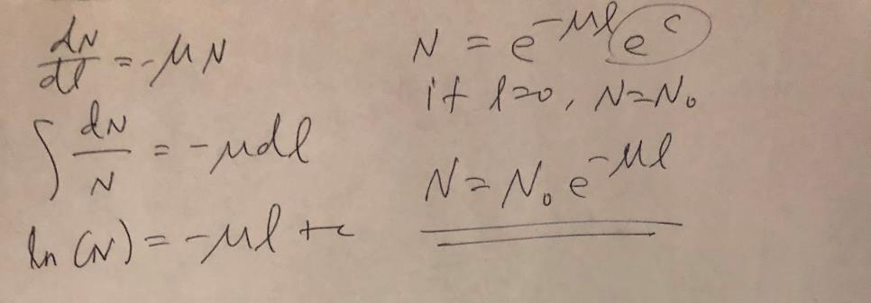
Similar to Beer’s Law
N(0)
# expected radioactive isotopes at t
N(0)
μ
N(l)
α
N(t)
Gamma ray emission over Δt
l
Δl
ΔN=-μN Δl
ΔN=-αN Δt

Slide 23
Unit of radioactivity:
1 Becquerel (Bq) = 1 expected desintegration / s imaging ~ 100 MBq
1 Curie (Ci) = 37 MBq (Ci is the older unit)
probability of measuring n photons when r photons are expected is Poisson distribution:
= average expected photons = standard deviation

Slide 24
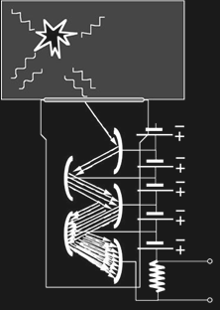
Data acquisition
Detectors
Scintillator + photomultiplier tube (PMT) (still used) SPECT crystal: optimized for ^{99m}Tc -> 140 keV -> NaI(Tl) PET crystal: optimized for 511 keV -> BGO, GSO, LSO
Scintillator + photodiode
Photoconductor (direct conversion)
γ-photons
scintillator
visible light
e⁻
photocathode
PMT
dynodes (+)
electric
current

Slide 25
Interaction of γ photons with matter E ~ 60 - 600 keV (e.g. E _{99mTc} = 140 keV)
attenuation is due to Compton scatter and photo-electric absorption
single photon emission:
(μ = linear attenuation coefficient)
example: median of penetration depth for ^{99m}Tc (140 keV) = 4.5 cm
photon pair emission (positron emission):
s=d
s=a
s
s=d₁
γ
γ
s=d₂
s=a
s
the attenuation is identical for each point along the projection line

Slide 26
Collimation -> measuring projection lines
SPECT: thick lead plate with cylindrical holes
PET: electronic collimation No absorption by lead collimator è sensitivity PET > sensitivity SPECT
γ
γ
γ

Slide 27
Fourier reconstruction and filtered backprojection (FBP)
Detected number of photons
SPECT:
PET:
Radon transform:
Not directly applicable due to attenuation!
Solution: transmission scan -> μ -> FBP for PET
s
y
f(x,y)
r
θ
x

Slide 28
Outline
Introduction
Beyond CT & MRI
Nuclear Imaging
Similarities & Differences
Nuclear Physics
Single & Paired γ Photon Emission
Imaging Models
SPECT & PET Systems
Key Components
Image Quality Issues
Novel Nuclear Imaging

Slide 29
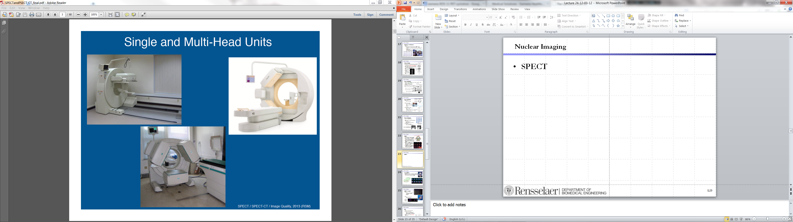
SPECT System

Slide 30
SPECT Images

Slide 31
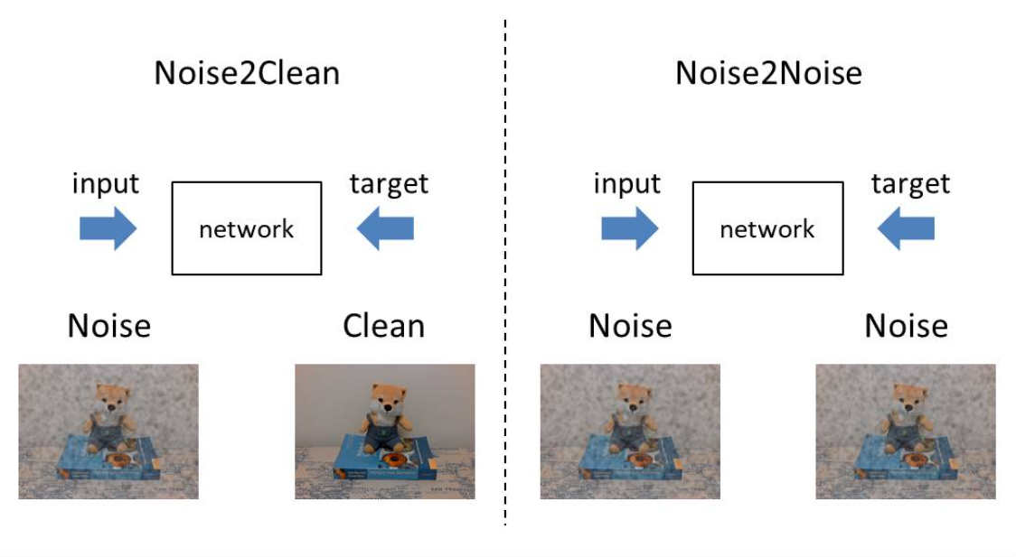
Noise2Noise
http://www.sanko-shoko.net/note.php?id=pn13 (Google Translation: Japanese to English; info@sanko-shoko.net)

Slide 32
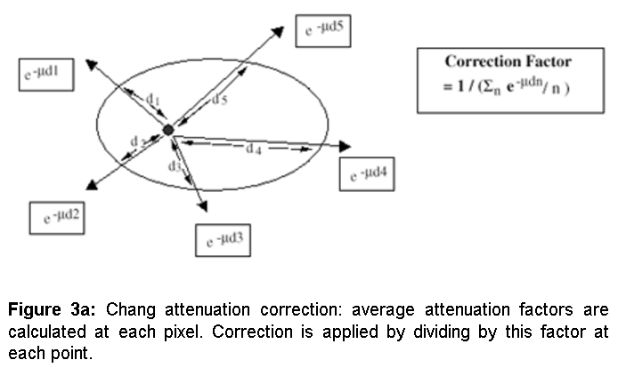
Heuristics for Attenuation Correction
Heuristic Method for Attenuation Correction

Slide 33
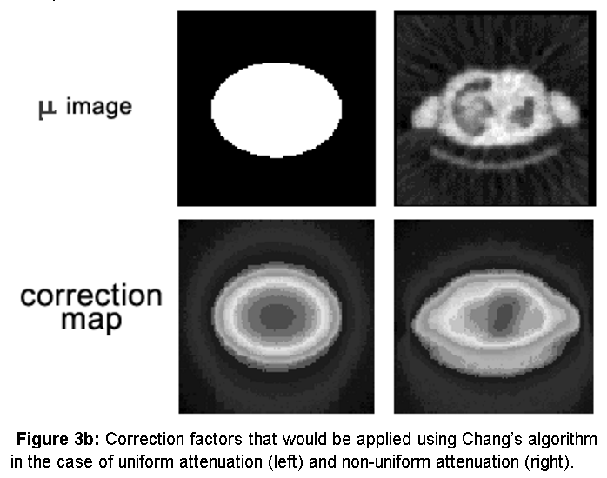
Smart Idea Illustrated

Slide 34
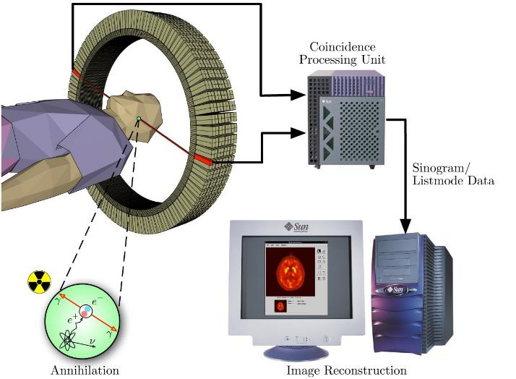
PET System

Slide 35
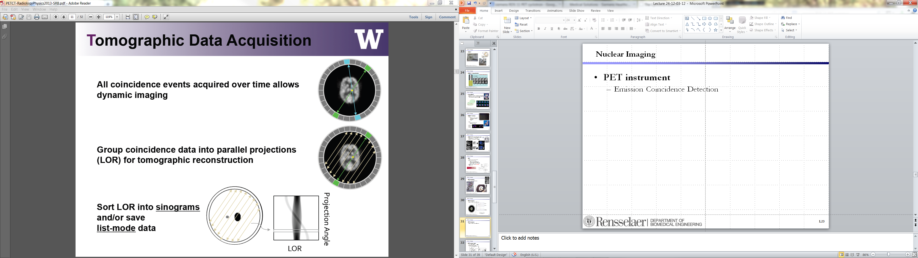
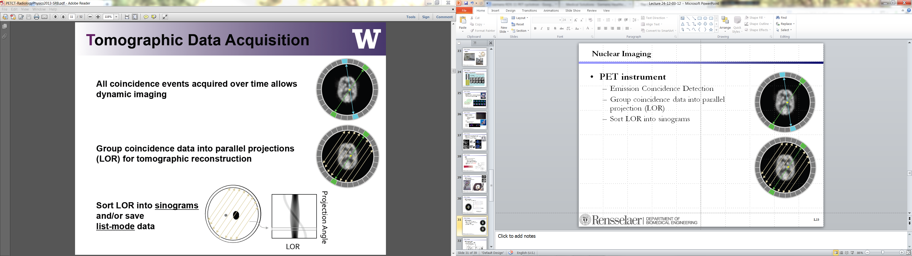
PET Sinogram
Emission Coincidence Detection
Group Data into Projection
(Line Of Response (LOR))
Form a Sinogram
❶
❸
❷

Slide 36
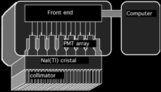

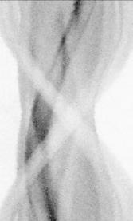
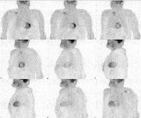
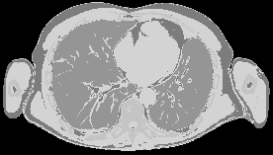
Result
Organized as projection images
Organized as a sinogram
Photon position: PMT ~ a few cm wide -> (x_{i},y_{i}) = position of PMT i [t₀,t₁] ~ a few 100 ns
(30-70 PMTs)
(50x40x1 cm)

Slide 37
Attenuation Correction
All new PET systems are PET/CT (used for attenuation correction)
photon energy in PET = 511 keV <-> in CT: spectrum
spectrum approximated by a single average energy (the effective energy) e.g. 140 kV -> effective energy 70 keV
piecewise linear relation between μ_{PET} and μ_{CT}
air

Slide 38

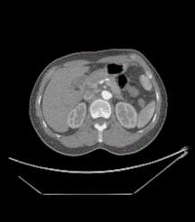
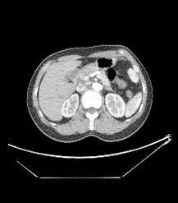
Virtual Monochromatic CT Imaging
Linear
Quadratic
Conv+ReLU
Residual Block
• • •
Residual Block
Conv+ReLU
Conv+ReLU
Poly CT
Image
Cubic
Mono CT
Image
Conv+ReLU
Conv+ReLU
Conv+ReLU

Slide 39
Outline
Introduction
Beyond CT & MRI
Nuclear Imaging
Similarities & Differences
Nuclear Physics
Single & Paired γ Photon Emission
Imaging Models
SPECT & PET Systems
Key Components
Image Quality Issues
Novel Nuclear Imaging

Slide 40
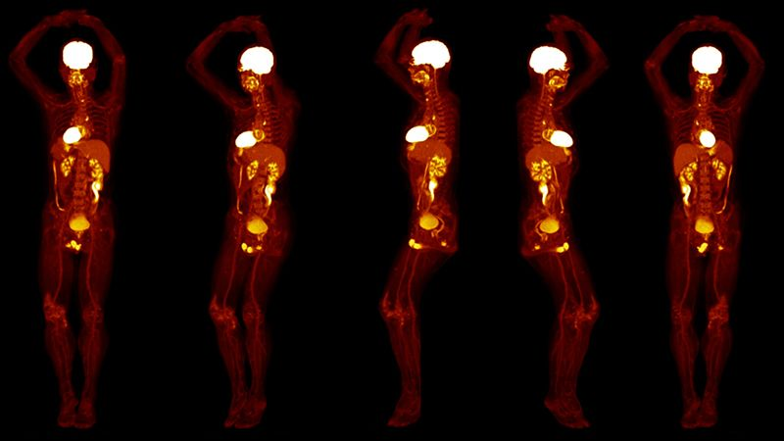
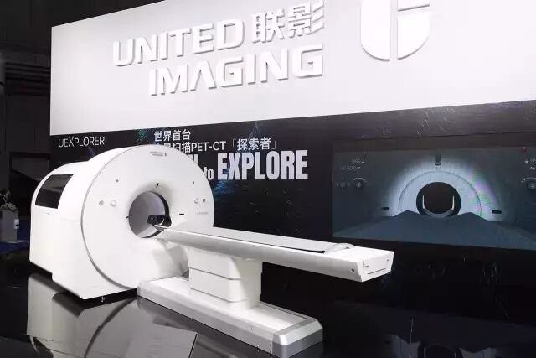
Whole Body PET

Slide 41
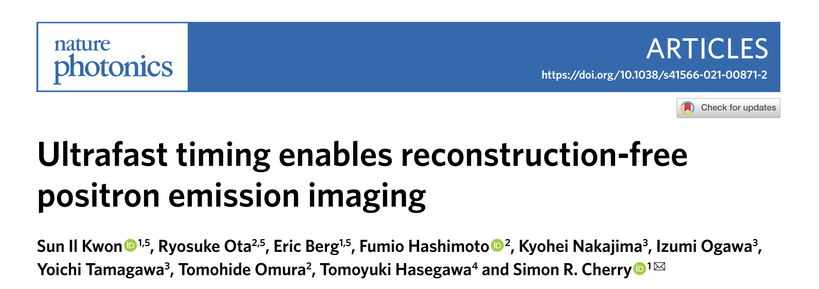
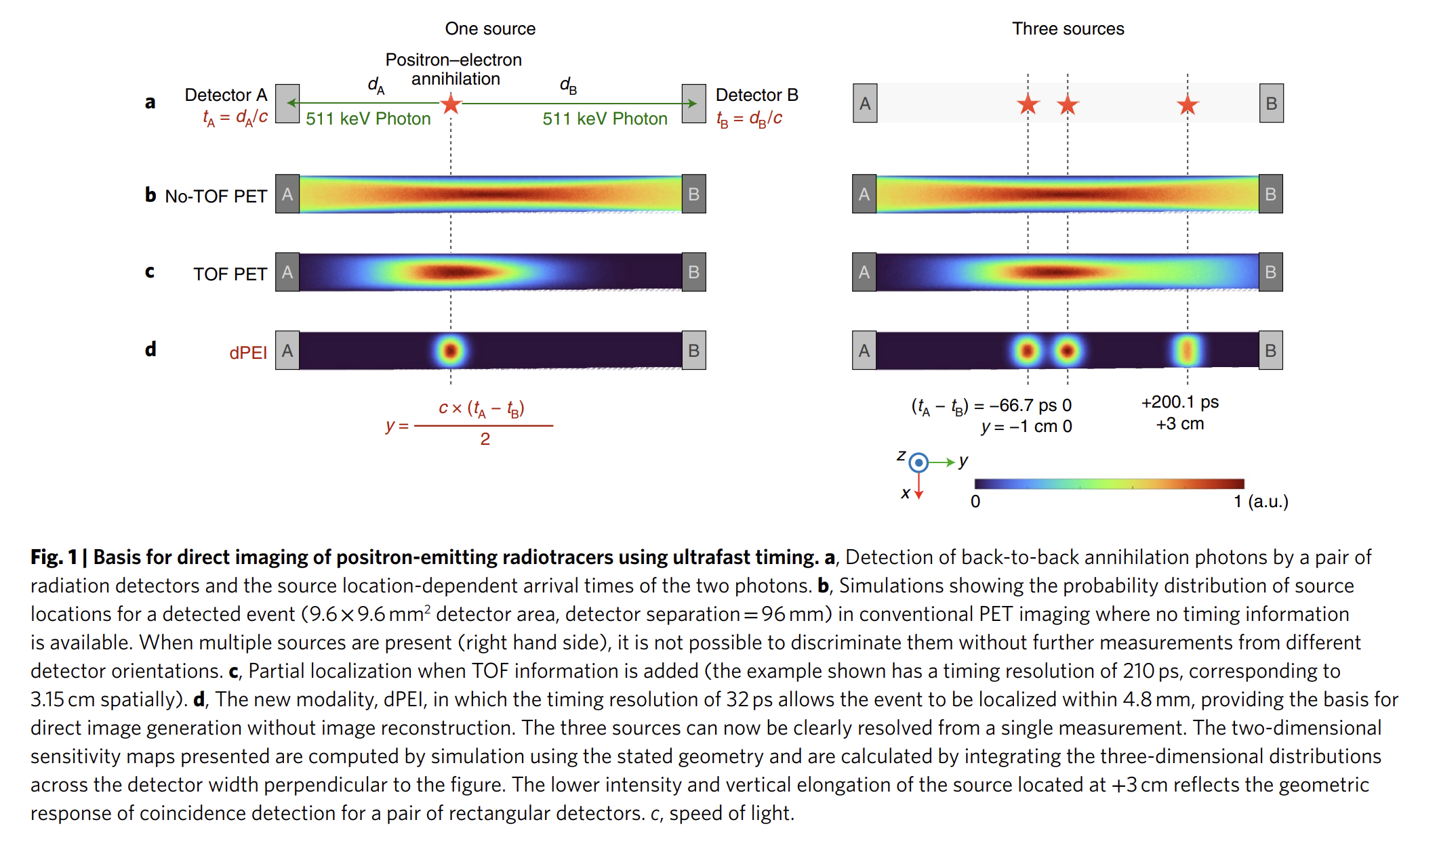
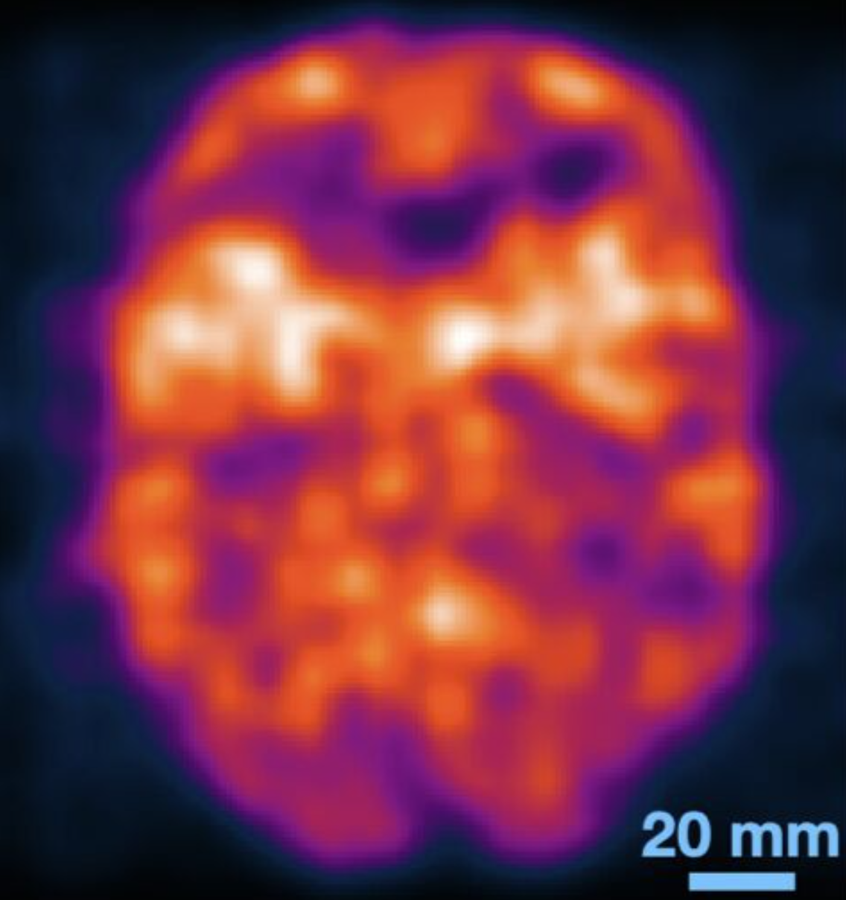
Time-of-Flight Based Reconstruction
Kwon, S.I., Ota, R., Berg, E. et al. Ultrafast timing enables reconstruction-free positron emission imaging. Nat. Photon. (2021). https://doi.org/10.1038/s41566-021-00871-2

Slide 42
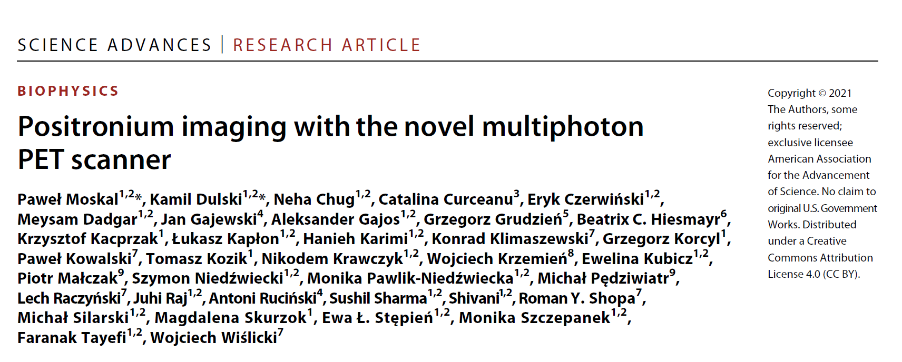
J-PET Prototype

Slide 43
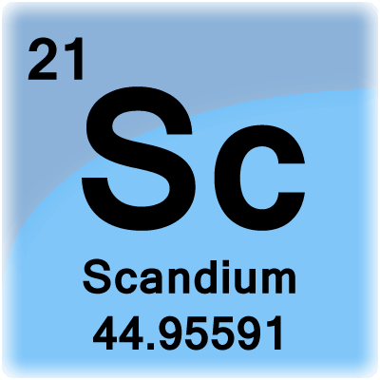
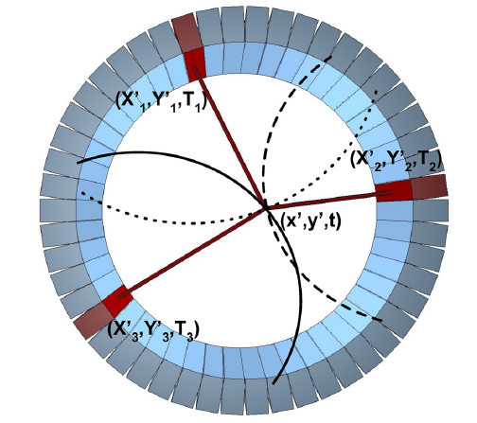
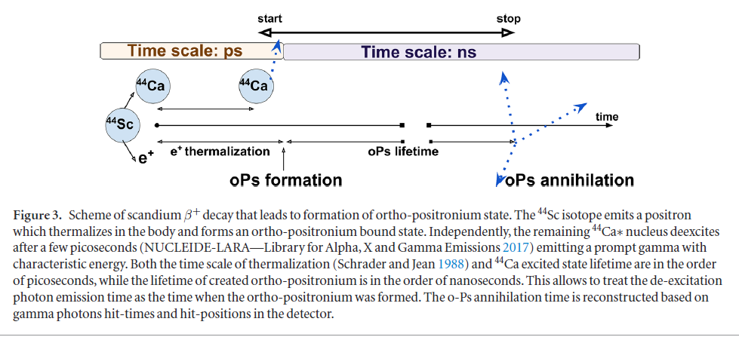
oPs Annihilation & Detection

Slide 44
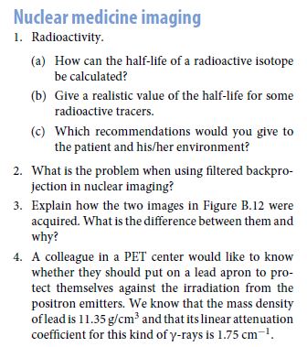
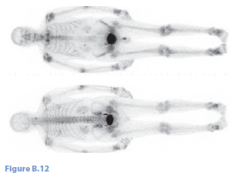
Homework

